Slide 1


Dept of CSE

Slide 2
IoT Sensing and Actuation
A major chunk of IoT applications involves sensing in one form or the other. Almost all the applications in IoT—be it a consumer IoT, an industrial IoT, or just plain hobby-based deployments of IoT solutions—sensing forms the first step
The basic science of sensing and actuation is based on the process of transduction. Transduction is the process of energy conversion from one form to another
Dept of CSE
A transducer is a physical means of enabling transduction. Transducers take energy in any form (for which it is designed)—electrical, mechanical, chemical, light, sound, and others—and convert it into another, which may be electrical, mechanical, chemical, light, sound, and others. Sensors and actuators are deemed as transducers

Slide 3
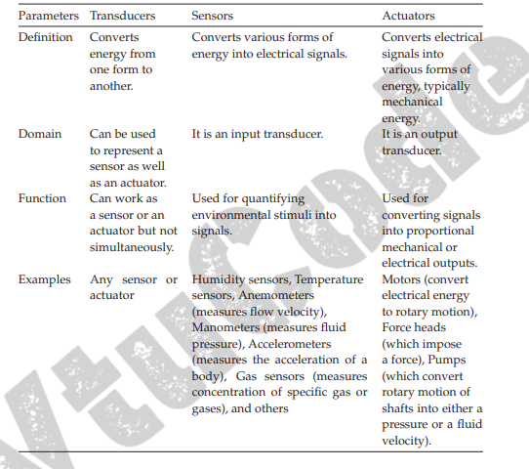
Dept of CSE

Slide 4
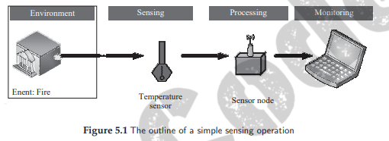
Sensors
Sensors are devices that can measure, or quantify, or respond to the ambient changes in their environment or within the intended zone of their deployment.
They generate responses to external stimuli or physical phenomenon through characterization of the input functions (which are these external stimuli) and their conversion into typically electrical signals
For example, heat is converted to electrical signals in a temperature sensor, or atmospheric pressure is converted to electrical signals in a barometer
Dept of CSE

Slide 5
Power Requirements: The way sensors operate decides the power requirements that must be provided for an IoT implementation. Some sensors need to be provided with separate power sources for them to function, whereas some sensors do not require any power sources. Depending on the requirements of power, sensors can be of two types.
Active: Active sensors do not require an external circuitry or mechanism to provide it with power. It directly responds to the external stimuli from its ambient environment and converts it into an output signal. For example, a photodiode converts light into electrical impulses.
ii) Passive: Passive sensors require an external mechanism to power them up. The sensed properties are modulated with the sensor’s inherent characteristics to generate patterns in the output of the sensor. For example, a thermistor’s resistance can be detected by applying voltage difference across it or passing a current through it.
Dept of CSE

Slide 6
Output: The output of a sensor helps in deciding the additional components to be integrated with an IoT node or system. Typically, almost all modern-day processors are digital; digital sensors can be directly integrated to the processors
Analog: Analog sensors generate an output signal or voltage, which is proportional (linearly or non-linearly) to the quantity being measured and is continuous in time and amplitude. Physical quantities such as temperature, speed, pressure, displacement, strain, and others are all continuous and categorized as analog quantities. For example, a thermometer or a thermocouple can be used for measuring the temperature of a liquid (e.g., in household water heaters). These sensors continuously respond to changes in the temperature of the liquid.
(ii) Digital: These sensors generate the output of discrete time digital representation (time, or amplitude, or both) of a quantity being measured, in the form of output signals or voltages. Typically, binary output signals in the form of a logic 1 or a logic 0 for ON or OFF, respectively are associated with digital sensors. The generated discrete (non-continuous) values may be output as a single “bit” (serial transmission), eight of which combine to produce a single “byte” output (parallel transmission) in digital sensors.
Dept of CSE

Slide 7
Measured Property of Sensors
Scalar: Scalar sensors produce an output proportional to the magnitude of the quantity being measured. The output is in the form of a signal or voltage. Scalar physical quantities are those where only the magnitude of the signal is sufficient for describing or characterizing the phenomenon and information generation. Examples of such measurable physical quantities include color, pressure, temperature, strain, and others. A thermometer or thermocouple is an example of a scalar sensor that has the ability to detect changes in ambient or object temperatures (depending on the sensor’s configuration). Factors such as changes in sensor orientation or direction do not affect these sensors (typically).
(ii) Vector: Vector sensors are affected by the magnitude as well as the direction and/or orientation of the property they are measuring. Physical quantities such as velocity and images that require additional information besides their magnitude for completely categorizing a physical phenomenon are categorized as vector quantities
Dept of CSE

Slide 8
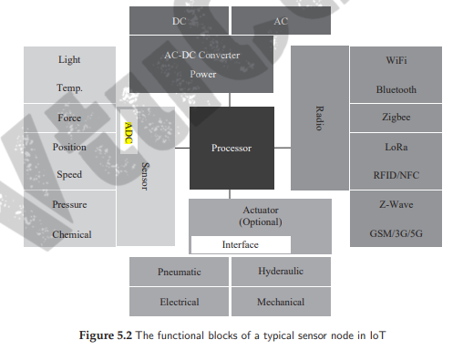
Dept of CSE

Slide 9
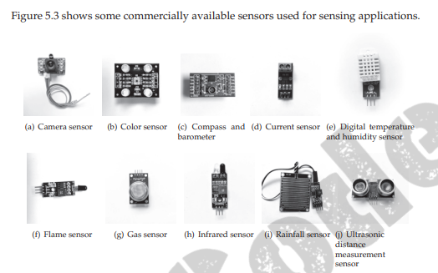
Dept of CSE

Slide 10
Sensor Characteristics
Sensor Resolution: The smallest change in the measurable quantity that a sensor can detect is referred to as the resolution of a sensor. For digital sensors, the smallest change in the digital output that the sensor is capable of quantifying is its sensor resolution. The more the resolution of a sensor, the more accurate is the precision. A sensor’s accuracy does not depend upon its resolution. For example, a temperature sensor A can detect up to 0.5 ◦ C changes in temperature; whereas another sensor B can detect up to 0.25◦ C changes in temperature. Therefore, the resolution of sensor B is higher than the resolution of sensor A
Dept of CSE
Sensor Accuracy: The accuracy of a sensor is the ability of that sensor to measure the environment of a system as close to its true measure as possible. For example, a weight sensor detects the weight of a 100 kg mass as 99.98 kg. We can say that this sensor is 99.98% accurate, with an error rate of ±0.02%
Sensor Precision: The principle of repeatability governs the precision of a sensor. Only if, upon multiple repetitions, the sensor is found to have the same error rate, can it be deemed as highly precise

Slide 11
Actuators
An actuator can be considered as a machine or system’s component that can affect the movement or control the said mechanism or the system.
Control systems affect changes to the environment or property they are controlling through actuators. The system activates the actuator through a control signal, which may be digital or analog
It elicits a response from the actuator, which is in the form of some form of mechanical motion
Dept of CSE
The control system of an actuator can be a mechanical or electronic system, a software-based system (e.g., an autonomous car control system), a human, or any other input

Slide 12
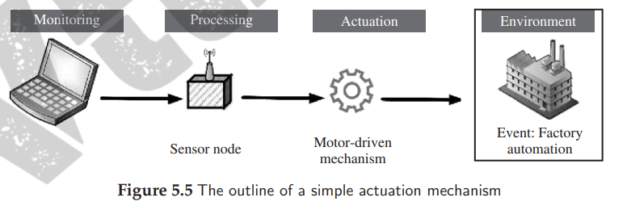
Dept of CSE

Slide 13
Actuator Types
1 Hydraulic actuators
A hydraulic actuator works on the principle of compression and decompression of fluids. These actuators facilitate mechanical tasks such as lifting loads through the use of hydraulic power derived from fluids in cylinders or fluid motors
https://www.youtube.com/watch?v=M1UddxRAjbc
Dept of CSE
2 Pneumatic actuators
A pneumatic actuator works on the principle of compression and decompression of gases. These actuators use a vacuum or compressed air at high pressure and convert it into either linear or rotary motion. Pneumatic rack and pinion actuators are commonly used for valve controls of water pipes
https://www.youtube.com/watch?v=qCMSx1n8-OU

Slide 14
3 Electric actuators
Typically, electric motors are used to power an electric actuator by generating mechanical torque. This generated torque is translated into the motion of a motor’s shaft or for switching (as in relays). For example, actuating equipments such as solenoid valves control the flow of water in pipes in response to electrical signals.
https://www.youtube.com/watch?v=0mOF5MgeplU
Dept of CSE

Slide 15
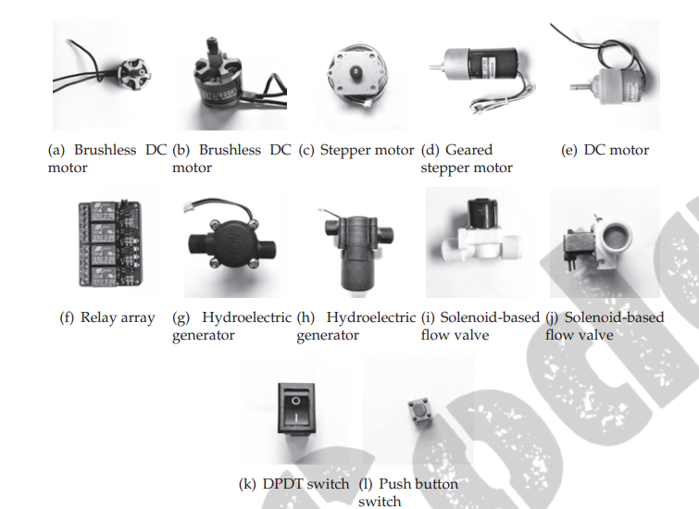
Dept of CSE

Slide 16
Thermal or magnetic actuators
The use of thermal or magnetic energy is used for powering this class of actuators. These actuators have a very high power density and are typically compact, lightweight, and economical. One classic example of thermal actuators is shape memory materials (SMMs) such as shape memory alloys (SMAs).
Mechanical actuators
In mechanical actuation, the rotary motion of the actuator is converted into linear motion to execute some movement. The use of gears, rails, pulleys, chains, and other devices are necessary for these actuators to operate. These actuators can be easily used in conjunction with pneumatic, hydraulic, or electrical actuators
Dept of CSE
Soft actuators
Soft actuators (e.g., polymer-based) consists of elastomeric polymers that are used as embedded fixtures in flexible materials such as cloth, paper, fiber, particles, and others

Slide 17
Shape memory polymers
Shape memory polymers (SMP) are considered as smart materials that respond to some external stimulus by changing their shape, and then revert to their original shape once the affecting stimulus is removed
Actuator Characteristics
Weight: The physical weight of actuators limits its application scope. For example, the use of heavier actuators is generally preferred for industrial applications and applications requiring no mobility of the IoT deployment
Dept of CSE
Power Rating: This helps in deciding the nature of the application with which an actuator can be associated. The power rating defines the minimum and maximum operating power an actuator can safely withstand without damage to itself
Torque to Weight Ratio: The ratio of torque to the weight of the moving part of an instrument/device is referred to as its torque/weight ratio. This indicates the sensitivity of the actuator. Higher is the weight of the moving part; lower will be its torque to weight ratio for a given power
Stiffness and Compliance: The resistance of a material against deformation is known as its stiffness, whereas compliance of a material is the opposite of stiffness

Slide 18
Dept of CSE

